Slide 1
Board of Directors’ Meeting, April 4-5, 2023 Abacus Polling Highlights Overview Mark Garcia, Government Relations and Advocacy Coordinator
Notes:
Acknowledge the lands we are on …

Slide 2
Methodology
2375 Canadians were polled aged 18 and over from November 25 to December 11, 2022. The margin of error was +/- 2.0%.

Slide 3
How do people feel about teachers’ unions?
38% of Canadians have a positive view of teachers’ unions;
28% neutral;
22% negative.

Slide 4
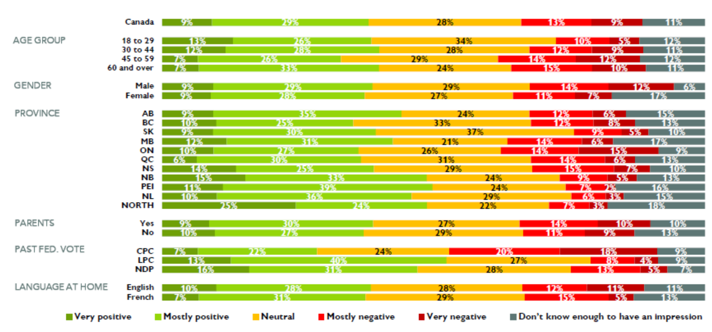
Canadians’ Impressions of Teachers’ Unions - Disaggregated
When we look for outliers, the best indicator of supporting teachers’ unions is previous federal vote. CPC voters do not like teachers’ unions.

Slide 5
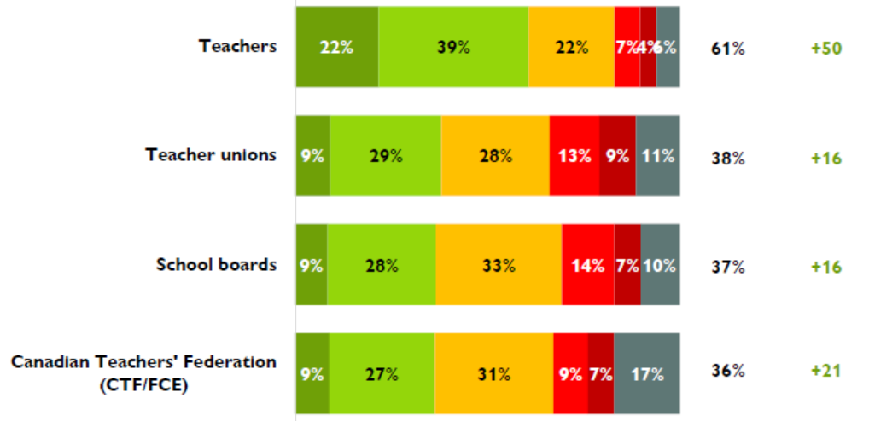
Feelings about teachers vs. other stakeholders.
Canadians had a net positive view of teachers of +50, this drops significantly to +16 for Teachers’ Unions and School Boards.
This reaffirms something we already knew. Your members are the best asset and humanizing the profession as much as possible will help us in our advocacy efforts.

Slide 6
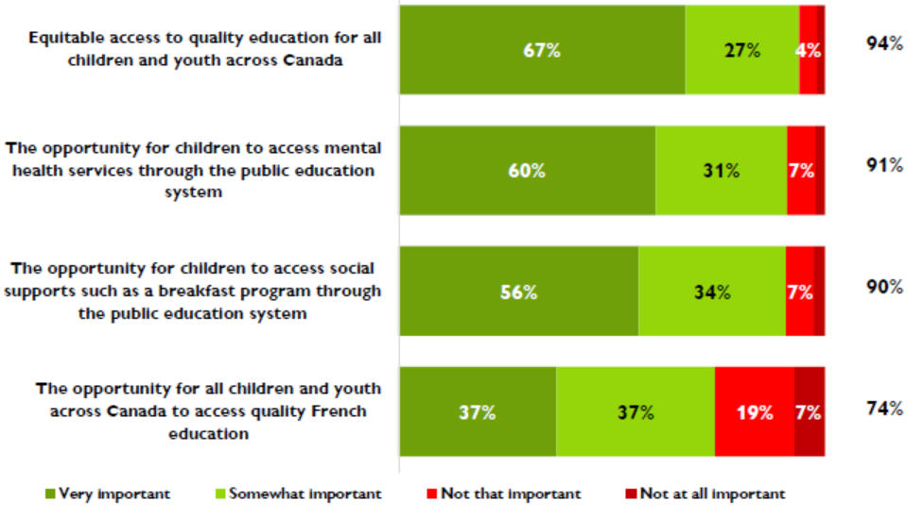
How important are the following issues to you?
94% of Canadians felt that equitable access to quality education for all children and youth across Canada was either somewhat important (27%) or very important (67%).

Slide 7
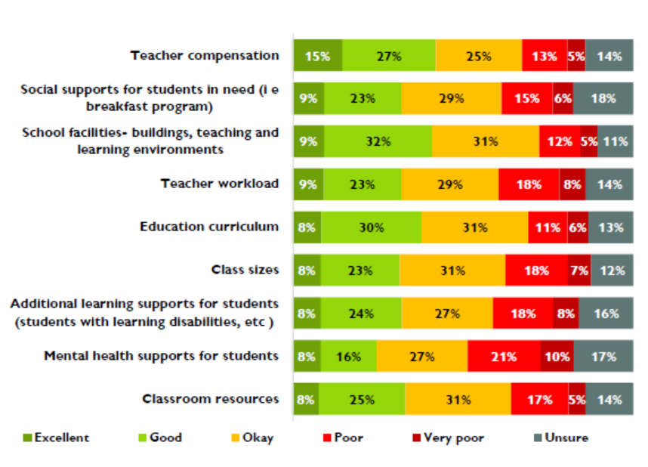
Thinking about the public education system in your area how would you rate the following?
Mental health supports for students are most in need of improvement according to Canadians.

Slide 8
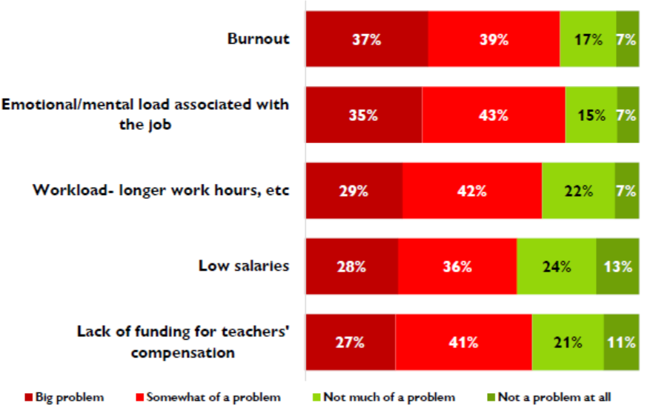
Do you think the following is a big problem or not much of a problem in the sector?
Canadians understand that there are problems facing teachers.

Slide 9
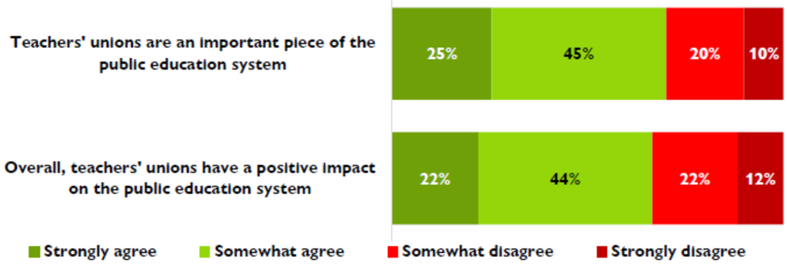
Are teachers’ unions important?
70% of Canadians agree teachers’ unions are an important piece of the public education system but…

Slide 10
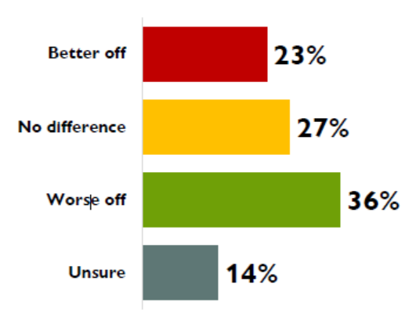
Are teachers’ unions important? (Cont’d)
Only 36% of Canadians think the education system would be worse off with no teachers’ unions. And 23% thinks it would be better off without teachers’ unions.

Slide 11
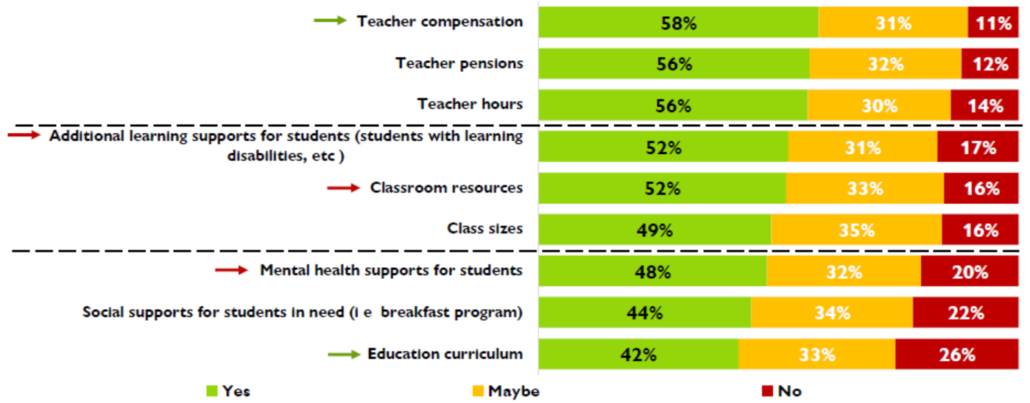
Should teachers’ unions play a role in negotiating the following?
Canadians want us to focus on teacher labour rights and less on curriculum and social supports. These findings coupled with the fact that these issues are important to Canadians make the case for the National Advisory Council on Publicly Funded Public Education.

Slide 12
Do you agree or disagree with the following statements about unions in general?
Nearly 60% of Canadians support teachers and their unions taking strike action.

Slide 13
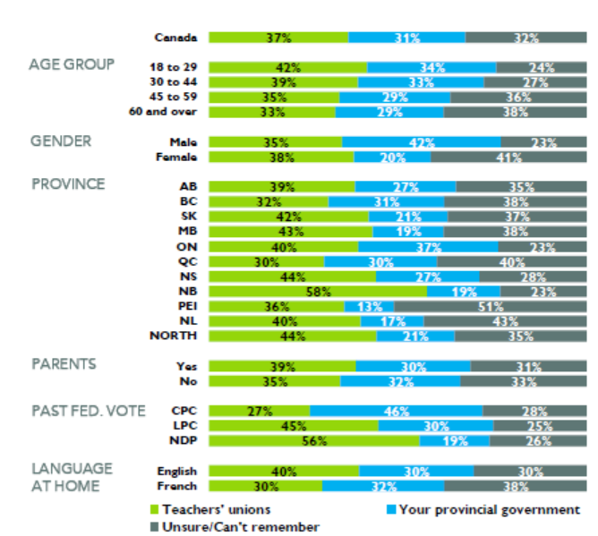
Who did you support last time your provincial/territorial government was in negotiations with teachers’ unions?
There is a gender imbalance when looking at this data, perhaps women feel less inclined to have a position or this is potential for us to grow support amongst women during negotiations.
without teachers’ unions.

Slide 14
The following are some ways the federal government can play a role in public education in Canada. For each, would you…
Canadians do want the federal government to play a larger role in public education; the CTF/FCE will continue to advocate for the NACE so that many of these issues can be supported federally.

Slide 15
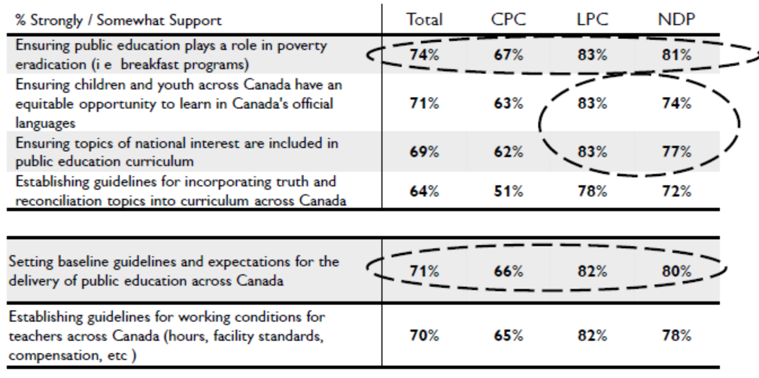
The following are some ways the federal government can play a role in public education in Canada. For each, would you…
This is generally how all Canadians feel even when you look at previous federal vote.

Slide 16
In closing…
If you’d like more information on the polling the CTF/FCE conducted contact Mark Garcia.
The survey results have a few minor changes to be made by Abacus before distribution (aesthetic changes) but we will share this with members in confidence.
Questions?
Notes:
Acknowledge the lands we are on …

